Slide 1
Carrier Recombination and Generation
Recombination of electrons and holes is a process by which both carriers annihilate each other: electrons occupy the empty state associated with a hole. Both carriers eventually disappear in the process and the energy difference between the initial and final state of the electron is released.
E_{released} = E₂ - E₁
Radiative recombination -- Photon is released
Non-radiative recombination -- Phonon is released
Auger recombination -- Kinetic energy is released (given off to another electron)
Dr. S. RANJITH / Physics, SRM IST

Slide 2
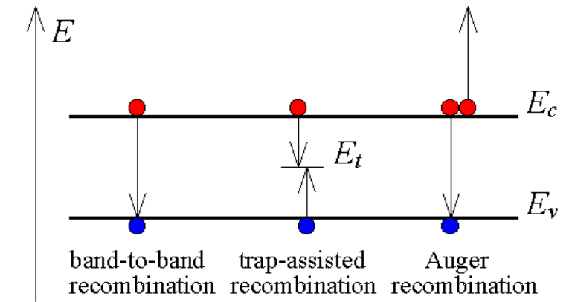
Carrier Recombination
Band-to-band: an electron moves from its conduction band state into the empty valence band
state associated with the hole (mechanism for radiative recombination).
Trap-assisted recombination: an electron falls into a "trap", an energy level within the bandgap
caused by the presence of a foreign atom or a structural defect (Shockley-Hall-Read)
Auger recombination: an electron and a hole recombine in a band-to-band transition, but now
the resulting energy is given off to another electron or hole.
Dr. S. RANJITH / Physics, SRM IST

Slide 3
Carrier Generation
Each carrier recombination method can be reversed to result in carrier
generation; therefore, a single expression can frequently be used to describe
both carrier generation and recombination.
Other Generation Mechanisms:
• Photon (light) absorption (related to band-to-band recombination
• High energy electron or particle beams
• Impact Ionization (related to Auger recombination)
• Direct charge injection
Dr. S. RANJITH / Physics, SRM IST

Slide 4
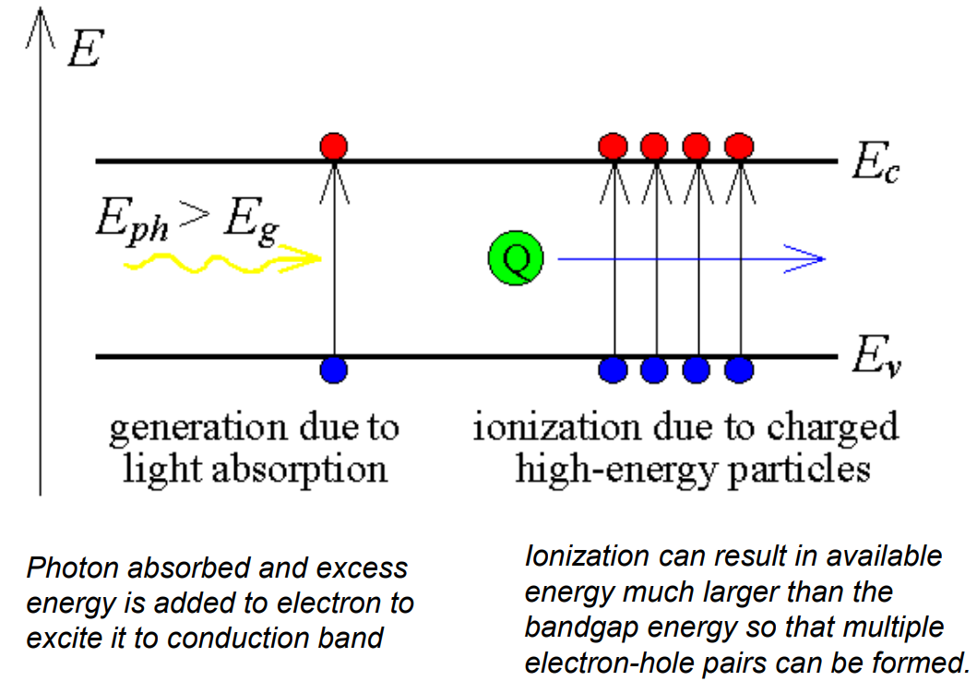
Carrier Generation
Dr. S. RANJITH / Physics, SRM IST

Slide 5

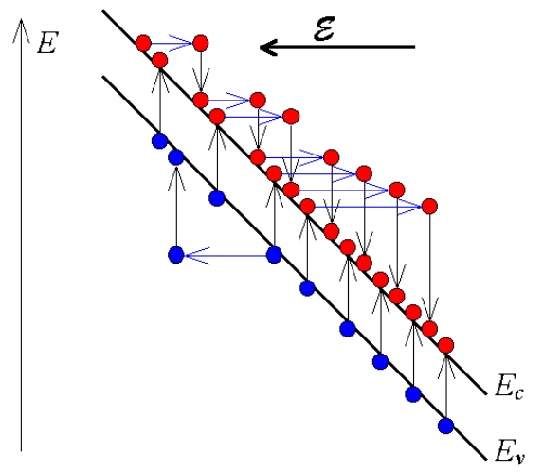
Carrier Generation: Impact Ionization
In Impact Ionization, the excess energy is given off to generate an electron-hole pair
through a band-to-band transition. This generation process causes avalanche
multiplication in semiconductor diodes under high reverse bias. The kinetic energy
is given off to an electron in the valence band, thereby creating an electron-hole pair.
The resulting two electrons can create two more electrons which generate four
more causing an avalanche multiplication effect. Electrons as well as holes
contribute to avalanche multiplication.
Dr. S. RANJITH / Physics, SRM IST

Slide 6
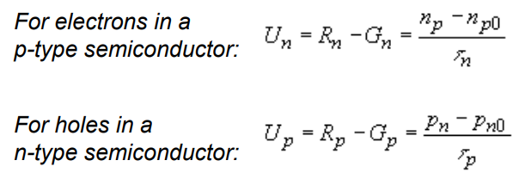
Simple Recombination-Generation Model
The recombination {R} minus the Generation {G} rate, resulting in a net rate {U},
is proportional to the excess carrier density. No net recombination takes place if the carrier
density equals the thermal equilibrium value.
Where τ is the average time after which an excess minority carrier recombines.
The recombination rate of the majority carriers depends on the
excess-minoritycarrier-density as the minority carriers limit the recombination rate.
Dr. S. RANJITH / Physics, SRM IST

